Slide 1
Introduction
Big Data may well be the Next Big Thing in the IT world.
Big data burst upon the scene in the first decade of the 21st century.
The first organizations to embrace it were online and startup firms. Firms like Google, eBay, LinkedIn, and Facebook were built around big data from the beginning.
Like many new information technologies, big data can bring about dramatic cost reductions, substantial improvements in the time required to perform a computing task, or new product and service offerings.

Slide 2
What is BIG DATA?
‘Big Data’ is similar to ‘small data’, but bigger in size but having data bigger it requires different approaches:
Techniques, tools and architecture
an aim to solve new problems or old problems in a better way
Big Data generates value from the storage and processing of very large quantities of digital information that cannot be analyzed with traditional computing techniques.

Slide 3
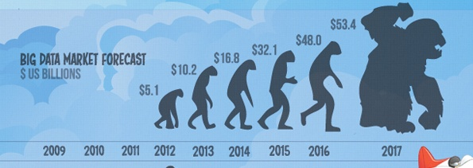
What is BIG DATA
Walmart handles more than 1 million customer transactions every hour.
• Facebook handles 40 billion photos from its user base.
• Decoding the human genome originally took 10years to process; now it can be achieved in one week.

Slide 4
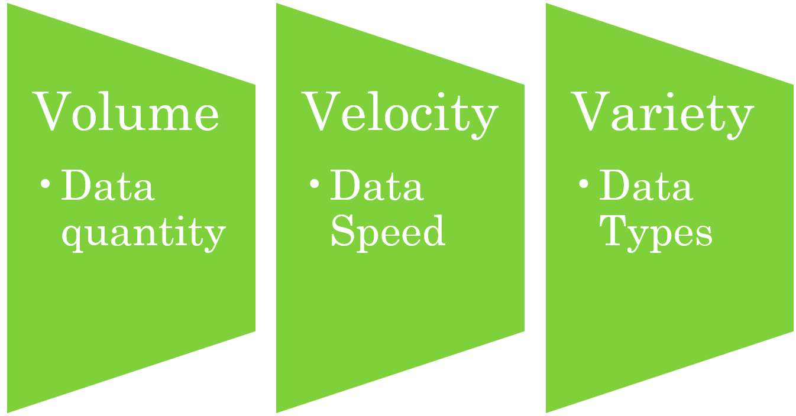
Three Characteristics of Big Data V3s

Slide 5
1st Character of Big Data Volume
A typical PC might have had 10 gigabytes of storage in 2000.
Today, Facebook ingests 500 terabytes of new data every day.
Boeing 737 will generate 240 terabytes of flight data during a single flight across the US.
The smart phones, the data they create and consume; sensors embedded into everyday objects will soon result in billions of new, constantly-updated data feeds containing environmental, location, and other information, including video.

Slide 6
2nd Character of Big Data Velocity
Clickstreams and ad impressions capture user behavior at millions of events per second
high-frequency stock trading algorithms reflect market changes within microseconds
machine to machine processes exchange data between billions of devices
infrastructure and sensors generate massive log data in real-time
on-line gaming systems support millions of concurrent users, each producing multiple inputs per second.

Slide 7
3rd Character of Big Data Variety
Big Data isn't just numbers, dates, and strings. Big Data is also geospatial data, 3D data, audio and video, and unstructured text, including log files and social media.
Traditional database systems were designed to address smaller volumes of structured data, fewer updates or a predictable, consistent data structure.
Big Data analysis includes different types of data

Slide 8
Storing Big Data
Analyzing your data characteristics
Selecting data sources for analysis
Eliminating redundant data
Establishing the role of NoSQL
Overview of Big Data stores
Data models: key value, graph, document, column-family
Hadoop Distributed File System

Slide 9
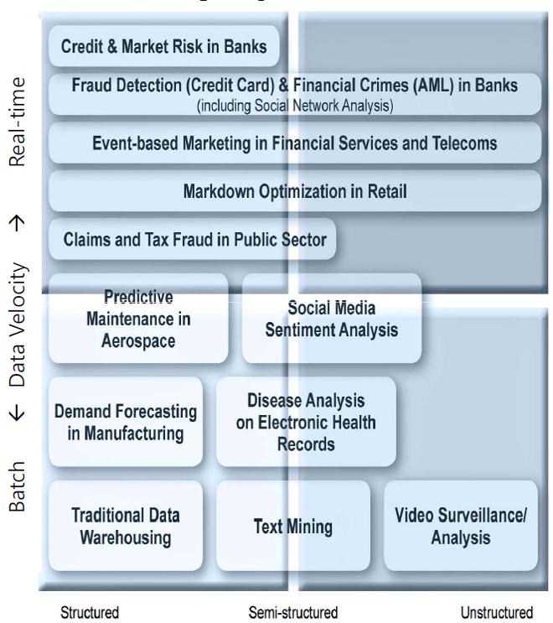
The Structure of Big Data
Structured
Most traditional data sources
Semi-structured
Many sources of big data
Unstructured
Video data, audio data

Slide 10
Why Big Data
Growth of Big Data is needed
Increase of storage capacities
Increase of processing power
Availability of data(different data types)
Every day we create 2.5 quintillion bytes of data; 90% of the data in the world today has been created in the last two years alone

Slide 11
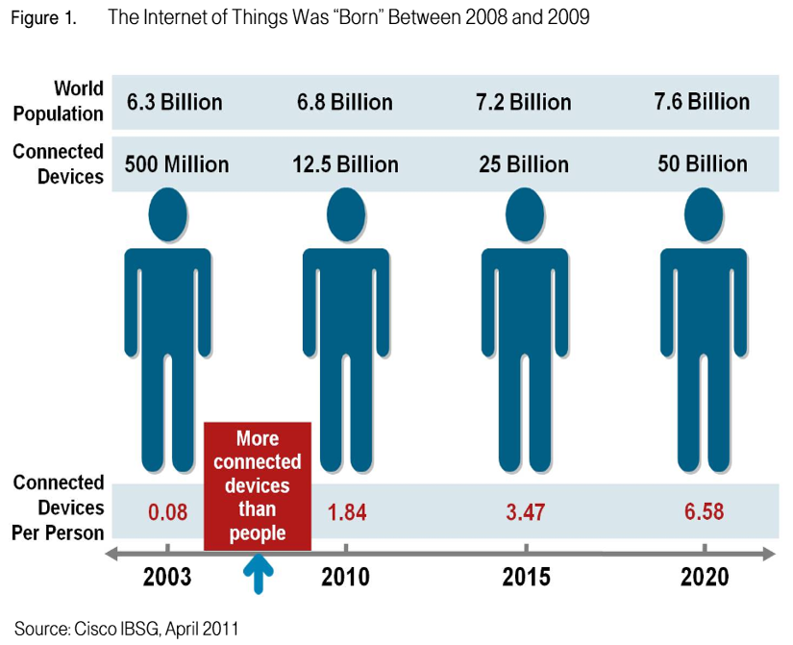
Why Big Data
FB generates 10TB daily
Twitter generates 7TB of dataDaily
IBM claims 90% of today’s stored data
was generated in just the last two years.

Slide 12
Applications
Smarter Healthcare
Traffic Control
Manufacturing
Multi-channel sales
Telecom
Trading Analytics
Search Quality

Slide 13
NoSQL
NoSQL is an approach to database design that can accomodate a wide variety of data models, including key-value, document, columnar and graph formats.
NoSQL, which stand for "not only SQL," is an alternative to traditional relational databases in which data is placed in tables and data schema is carefully designed before the database is built.
NoSQL databases are especially useful for working with large sets of distributed data.

Slide 14
Major issues of Relational Databases
Relational databases were designed for tabular data, with a consistent structure and a fixed schema. They work best for problems that are well defined at the outset. But not good to manage unstructued data.
A Large Number of JOINs
When you utilize queries that join many different tables, there’s an explosion of complexity and computing resource consumption. This results in a corresponding increase in query response times.
Frequent Schema Changes
Slow-Running Queries (Despite Extensive Tuning)

Slide 15
Why NoSQL
Document Oriented Storage: Data is stored in the form of JSON style documents.
Replication and high availability
Auto-sharding
Rich queries
Fast in-place updates

Slide 16
Characterisics of NoSQL
It’s more than rows in tables—NoSQL systems store and retrieve data from many formats: key-value stores, graph databases, column-family (Bigtable) stores, document stores, and even rows in tables.
It’s free of joins—NoSQL systems allow you to extract your data using simple interfaces without joins.
It’s schema-free—NoSQL systems allow you to drag-and-drop your data into a folder and then query it without creating an entity-relational model.
It works on many processors—NoSQL systems allow you to store your database on multiple processors and maintain high-speed performance.
It uses shared-nothing commodity computers—Most (but not all) NoSQL systems leverage low-cost commodity processors that have separate RAM and disk.
It supports linear scalability—When you add more processors, you get a consistent increase in performance.

Slide 17
Data Models of NoSQL
Key-value datamodel
Document data model
Column Family data model
Graph data model

Slide 18
MongoDB is a _________ database that provides high performance, high availability, and easy scalability. a) graph b) key value c) document d) all of the mentioned
What does “Velocity” in Big Data mean?
a) Speed of input data generation
b) Speed of individual machine processors
c) Speed of ONLY storing data
d) Speed of storing and processing data

Slide 19
Thank You.

